Slide 1
Gary Radloff, Sheldon Du, Pam Porter and Troy Runge

Slide 2
Agenda
Background: Research for WI Energy Office
Quality
  Survey on sample properties
  Impact on conversion limitations
Quantity
  Where is the biomass?
  How much is available? At what cost?
Impact to current business and next steps
Notes:
Is this needed?

Slide 3
Theme and Topics
Planning a transition to new energy economy
Biomass is already WI leading renewable energy source
  Have abundant supply for the future
Biogas leading opportunity: On-Farm AD, Wastewater Treatment Plants AD, and Landfill Diversions and CHP combinations & thermal
Need supportive public policy to achieve success in Wisconsin

Slide 4
Simplified Conversion Pathways
Biomass to Energy/Fuels
Wood Residuals
Combustion
Heat & Power
Grasses & Corn Stover
Pyrolysis / Gasification
Solid fuels
Manure
Saccharification & fermentation
Liquid fuels
Transportation
Solid Waste
Anaerobic digestion
Gaseous fuels
Primary
Secondary

Slide 5
Wisconsin Biomass Numbers
Biomass Type / Estimate methodology | Million Dry Tons/year
Corn Stover Estimates
NASS Data | 2.81
BTS Data@$60/MT | 2.49
Wood Residuals
TPO Roundwood | 1.29
TPO Harvest residuals | 1.52
Energy Crops
BTS Woody@$60/MT | 2.29
BTS Grasses@$80/MT | 0.15
WBA Fallow Hay/CRP | 3.13
Manure
NASS Dairy Aus | 4.77
Notes:
Showing general number with different data source estimates

Slide 6
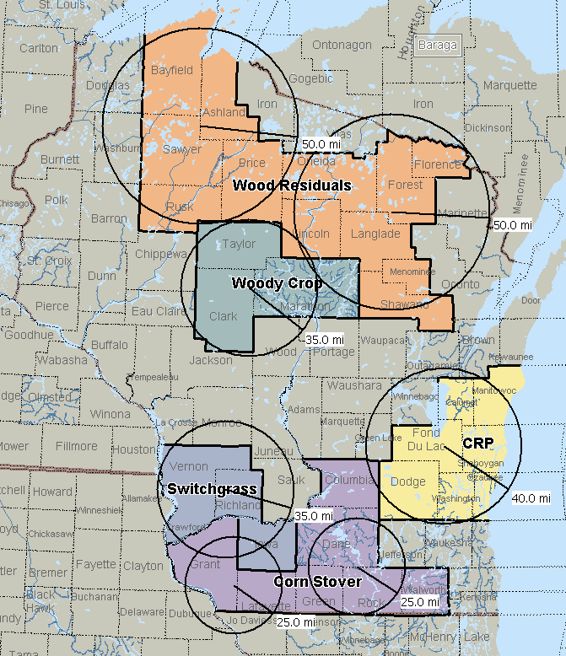
Biomass Opportunities
Identified top counties with biomass densities
Looked for natural groupings
Used circles to identify processing sites >200,000 tons/year

Slide 7
Quality - Biomass Analyses
Proximate Analysis
  Moistures, Volatile Matter, Fixed Carbon, Ash
Heating Value
Ultimate Analysis
  C, H, N, O, S
Cl, Hg, Mineral Ash Analysis
Crude Protein
Carbohydrate
Lignin
Notes:
Is this needed?

Slide 8
Identified Thermal Conversion Issues
Fuel Characteristic | unit | Woody | Herbaceous | Residuals
Moisture | (% wt wb) | 2.74% - 49.94% | 2.45% - 18.32% | 6.96% - 28.62%
LHV | Btu/lb | 3200 - 8946 | 5926 - 6923 | 5019 - 8145
Ash | (% wt db) | 0.63% - 9.33% | 2.66% - 10.83% | 5.21% - 19.38%
N | ppm db | 200 - 10200 | 3700 - 15500 | 2500 - 42700
S | ppm db | 110 - 670 | 370 - 3130 | 1400 - 8590
Cl | ppm db | 19 - 617 | 293 - 6516 | 786 - 12550
Hg | ppm db | <0.001 - 0.024 | <0.001 - 0.017 | <0.001 - 0.027
Fouling Index | lb alkali/MMBtu | 0.099 - 1.471 | 0.227 - 1.919 | 0.314 - 1.482

Slide 9
Quality Summary
Link known technologies with Biomass based on quantity
Thermochemical → Woody & Woody Waste
  Combustion
  Gasification
Biological → Herbaceous & Herbaceous Waste
  Fermentation
  Anaerobic digestion

Slide 10
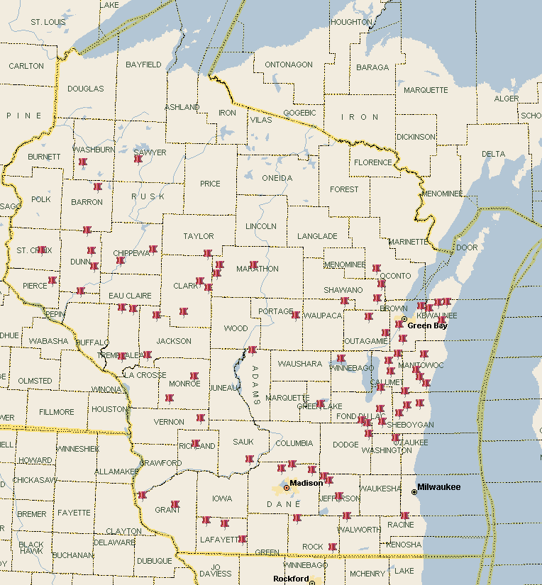
Biomass Opportunities
Manure assumed to be on CAFOs

Slide 11
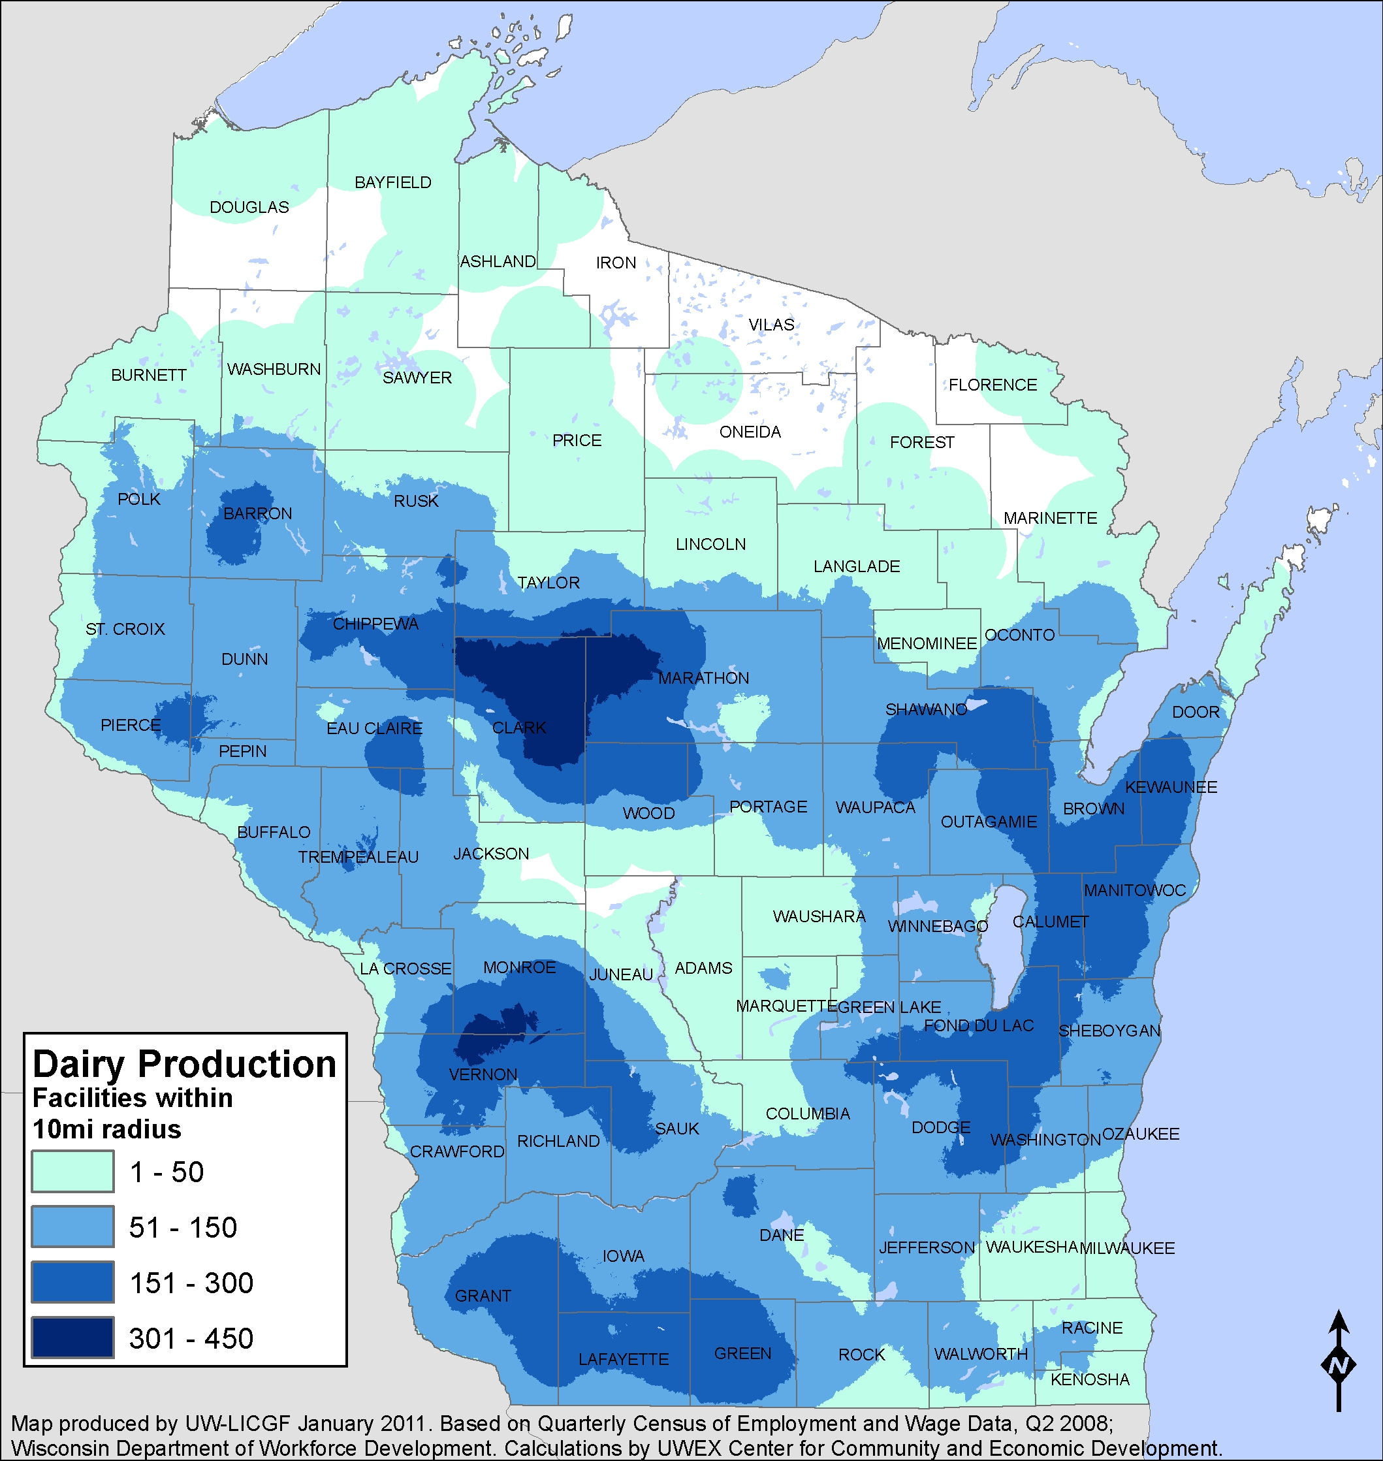

Slide 12
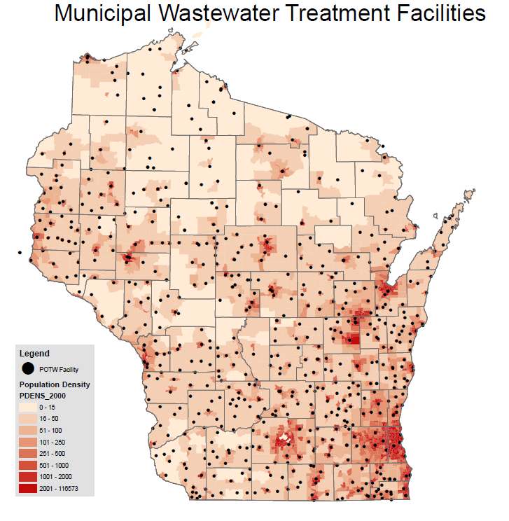

Slide 13
Woody Biomass Economic Scenarios
Residuals and pulpwood markets
  RPS demand for woody biomass
  Biofuel feedstock demand
  Pulpwood demand from pulp/paper industry
  Mill capacity expands or contracts by 10%
Potential overlaps
  High bioenergy demand
  Expanding pulp/paper markets

Slide 14
Analysis Framework-Scenarios
Price
Sawlogs
Pulp/Paper industry demand
Pulpwood
Bioenergy demand (RPS, RFS…)
Residue
Quantity

Slide 15
Impact to Existing Industry
Most developed biomass industry is forest products
Wisconsin has a large pulp & paper industry
What would the impact of increased woody biomass demand be?
Roundwood (MCF) | Sawlogs | Pulpwood
360.8 | 98.2 (27%) | 250.8 (70%)
Source: Wisconsin Timber Industry: An Assessment of Timber Product Output and Use in 2003. http://nrs.fs.fed.us/pubs/rb/rb_nrs19.pdf

Slide 16
Impact on NW Region Pulpwood Market

Slide 17
Conclusions
Wisconsin has a large amount of biomass available for bioenergy projects
Pockets of high density biomass create opportunities for aggregation
Woody biomass is only source tested to consistently have quality need for thermal conversion
With a developed forest products industry only wood residuals can be used without impacting regional wood prices
  NW region of WI - 2 plants at 200,000 ton/year each
  NE region of WI - 1 plants at 200,000 ton/year each

Slide 18
Conclusions Part II
WI should look to investments in waste handling and processing as opportunities for energy production (wastewater treatment, landfills and industrial sites).
Biomass feedstock manure is already aggregated at CAFOs and farms, these are logical energy sites
Small to mid-size thermal is cost competitive today with propane and heating oil. WI can do much more.
Tipping Point for WI: A highly vulnerable economy dependent on global energy or innovative domestic leadership in biogas, thermal, CHP and microgrids.

Slide 19
Gary Radloff gradloff@wbi.wisc.edu

