Slide 1
Price Dynamics in Wisconsin Woody Biomass Markets

Slide 2
Questions and Results Preview
Questions
  Where, in what quantities and at what prices will wood residuals be available in Wisconsin?
  Will bioenergy development have significant price impacts on regional pulpwood markets, and to what extent?
Preview of the main results
  Given the biomass demand of 0.2 MM dt/yr, Northern Wisconsin can support 3 conversion plants by using only residuals
  If total demand exceeds 1.2 MM dt/yr, significant impact on regional pulpwood prices will occur

Slide 3
Agenda
Roundwood markets in WI
Economic analysis framework, scenarios and data
Residual supply and demand analysis
Impact of bioenergy development on regional pulpwood markets
Conclusion

Slide 4
Roundwood Markets in Wisconsin
We focus on pulpwood and sawlogs
Roundwood (MCF) | Sawlogs | Pulpwood
360.8 | 98.2 (27%) | 250.8 (70%)
Source: Wisconsin Timber Industry: An Assessment of Timber Product Output and Use in 2003. http://nrs.fs.fed.us/pubs/rb/rb_nrs19.pdf
Notes:
Wisconsin has been the number one paper making state in the nation for over 50 years.
Source: Wisconsin Timber Industry: An Assessment of Timber Product Output and Use in 2003 (the most recent report by USDA, forest service, Northern Research Stattion.
Figure 3. Wisconsin industrial roundwood production by category and year.
2003 production (in Million Cubit Feet) and percentages for pulpwood and sawlogs

Slide 5
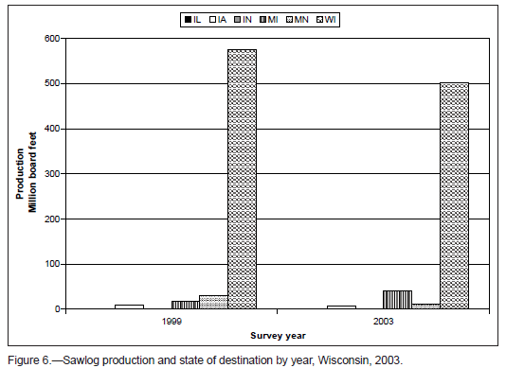
Inter-State Trade
Inter-state trades are limited
2003 Production in WI | Destinations
Pulpwood | WI (81%) | MN (11%) | MI (8%)
Sawlogs | WI (89%) | MN (2%) | MI (7%)
Source: Wisconsin Timber Industry: An Assessment of Timber Product Output and Use in 2003.
Notes:
Figure 4-A: Wisconsin roundwood pulpwood production in 2003 and state of destination

Slide 6
Model Structure
For State or each region
Forest resources
Sawlogs
Pulpwood
Residuals
Price
Price
Supply
Supply
Demand
Demand
Trade
Trade
Pulp mill capacity

Slide 7

Analysis Framework-Baseline
Price
Sawlogs
Pulp/Paper industry demand
Bioenergy demand (RPS)
Pulpwood
Residuals
$$\overline{Q}$$
Quantity

Slide 8






Analysis Framework-Scenarios
Price
$$D′$$
$$D$$
$$D′′$$
Sawlogs
$$B′$$
Pulp/Paper industry demand
$$B$$
Bioenergy demand (RPS+biofuel)
Pulpwood
Residuals
$$\overline{Q}$$
Quantity

Slide 9
Scenarios
Residual and pulpwood markets
  RPS demand for woody biomass
  Biofuel/bioenergy feedstock demand
  Pulpwood demand from pulp/paper industry
  Mill capacity expands or contracts by 10%
Potential overlaps in pulpwood market
  High bioenergy demand for pulpwood
  Expanding pulp/paper markets

Slide 10
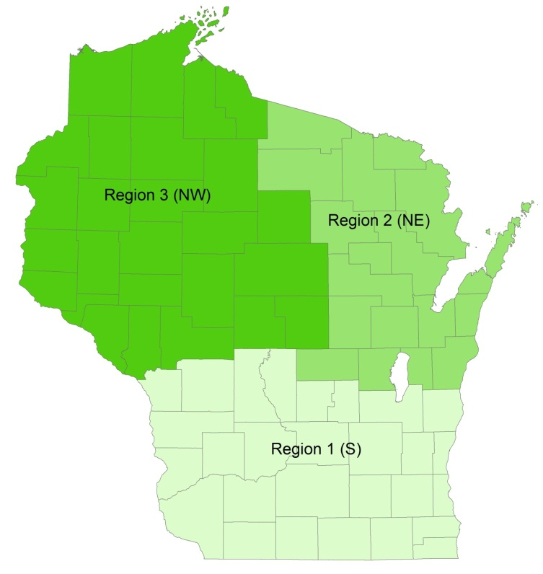
Data
Wisconsin’s 3 regions
  region 1: South
  region 2: NE
  region 3: NW
Pulpwood
  Annual production and price data over 1996-2008
  Quantity: Northern Research Station, NFS
  Price: Timber Mart North© Price Report
  Demand shifter: pulp mill capacity (Lockwood Post Annual Directory)

Slide 11
Pulpwood Production, Delivered Price and Pulp Mill Capacity (Normalized) in WI (1996-2011)
Price: 1996-2011 ($/ton)
Production: 1996-2008 (cords; /100,000)
Capacity: 1996-2011 (tons/yr; /200)

Slide 12
Data, Cont’d
Residuals
  Billion Ton Study (BTS) supply curve
Saw logs
  Production survey data for 1996, 1999, 2003 and 2008
  Price: Timber Mart North© Price Report
  Not modeled specifically because of data limitation

Slide 13
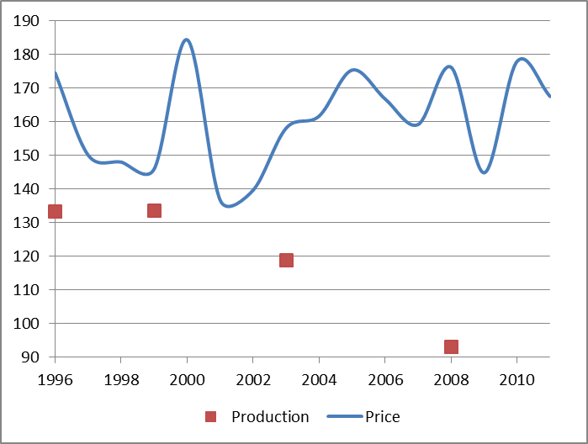
Saw Logs Delivered Prices and Production (Normalized) in WI
Price: 1996-2011 ($/mbf)
Production: 1996-2008 (mbf; /10,000)

Slide 14
Residual Supply/Demand Analysis
Notes:
Vertical part of the supply curve indicates the limit of available residuals. No matter how high the price goes, there is not more residuals exists.

Slide 15
Residuals – State Level
Supply curve (BTS 2012)
Demand from RPS: 5.55% (1.3%) for 2010~14, and 9.55% (2.0%) by 2015 from renewable resources (residuals)
2010
2015
19.3
16.0
203,000
313,000
Wisconsin's Electric Power Industry Net Generation
 |  |  |  |  |  | (thousand megawatthours)
 |  | 2003 | 2004 | 2005 | 2006 | 2007 | 2008 | 2009 | 2010-2014 | 2015
Total |  | 60,122 | 60,445 | 61,825 | 61,640 | 63,391 | 63,480 | 59,959 | 64,314 | 64314
Renewables |  | 3,069 | 3,094 | 2,922 | 2,944 | 2,846 | 3,370 | 3,734
 | (Percent of State Total, %) | 5.1 | 5.1 | 4.7 | 4.8 | 4.5 | 5.3 | 6.2
 | Wood/Wood Waste | 757 | 605 | 740 | 774 | 785 | 775 | 769 | 836 | 1286
 | (Percent of State Total, %) | 1.3 | 1.0 | 1.2 | 1.3 | 1.2 | 1.2 | 1.3 | 1.3 | 2.0
*Source: | State Renewable Electricity Profiles 2007, State Renewable Electricity Profiles 2009 (EIA) |  |  |  |  |  |  |  | 203,000 | 313,000
** 3.55% for the years 2006~2009, 5.55% for the years 2010~2014, and 9.55% by 2015
*** average over species

Slide 16
Residuals – Regional Level
2010
2015
26.9
22.7
215,100
111,000
171,000
 |  |  | 2010 | 2015
Electricity generation (1,000 MWH) |  |  | 35,072 | 35,072
 | From wood residue |  | 1.30% | 2.00%
 |  |  | 455.9 | 701.4
RPS residue demand (tons) |  |  | 111,000 | 171,000

Slide 17
Residuals – Region 2 (NE)
2010
2015
19.6
15.8
316,100
54,580
91,273
 |  |  | 2010 | 2015
Electricity generation (1,000 MWH) |  |  | 17,254 | 17,254
 | From wood residue |  | 1.30% | 2.00%
 |  |  | 224.3 | 345.1
RPS residue demand (tons) |  |  | 54,580 | 91,273

Slide 18
Residuals – Region 3 (NW)
2010
2015
13.4
10.2
516,900
37,911 58,351
 |  |  | 2010 | 2015
Electricity generation (1,000 MWH) |  |  | 11,988 | 11,988
 | From wood residue |  | 1.30% | 2.00%
 |  |  | 155.8 | 239.8
RPS residue demand (tons) |  |  | 37,911 | 58,351

Slide 19
Summary - Residuals
Rich source of wood residuals in Regions 2 (NE) and 3 (NW), not in Region 1 (S), after satisfying the demand of RPS (0.7 MM dt)
Assume the demand of 0.2 MM dt for biofuel feedstock, NW and NE regions in WI can support 2 and 1 conversion plants, respectively, using only residuals
Higher demand may impact pulpwood market, which is illustrated by assuming incremental increase of biofuel feedstock demand

Slide 20

Analysis Framework-Scenarios
Price
Sawlogs
Pulp/Paper industry demand
Bioenergy demand (RPS)
Pulpwood
Residuals
$$\overline{Q}$$
Quantity

Slide 21
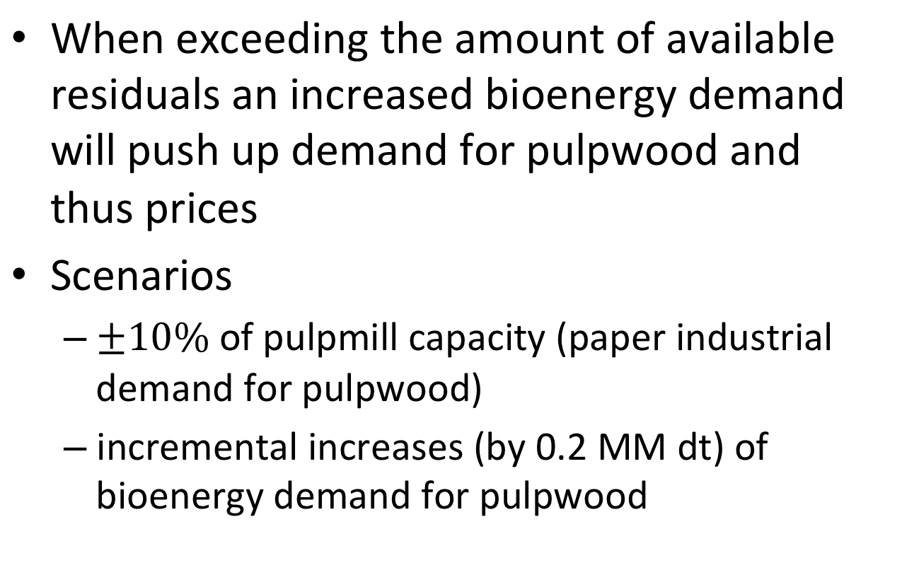
Impact of Bioenergy Development
When exceeding the amount of available residuals an increased bioenergy demand will push up demand for pulpwood and thus prices
Scenarios
  of pulpmill capacity (paper industrial demand for pulpwood)
  incremental increases (by 0.2 MM dt) of bioenergy demand for pulpwood

Slide 22
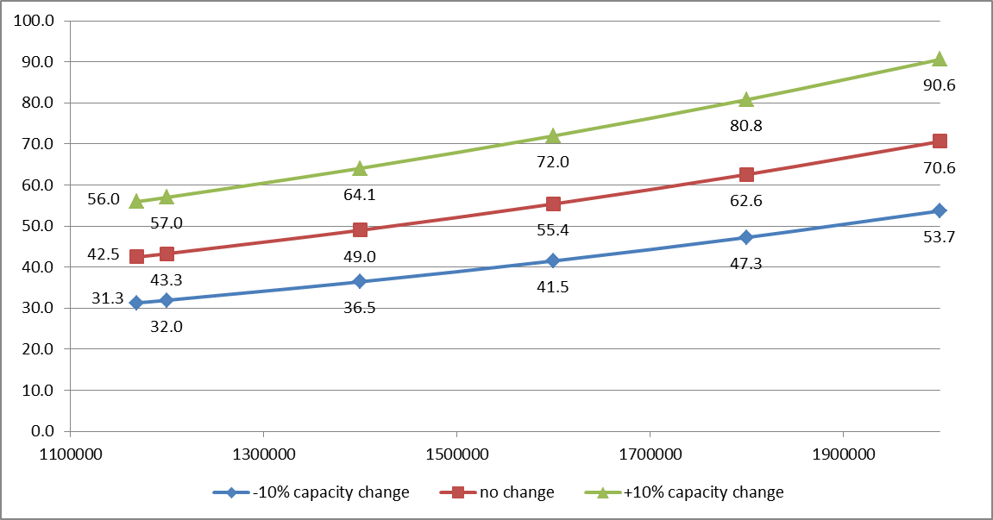
Impact on Regions 2 and 3 (NE/NW) pulpwood market

Slide 23
Conclusion
Given the biomass demand of 0.2 MM dt/yr, Northern Wisconsin can support 3 conversion plants by using only residuals
  2 in the NW Region
  1 in the NE Region
If demand from biofuel/bioenergy sectors rises above 1.2 MM dt/yr it could have significant impact on regional pulpwood prices

Slide 24
Sheldon Du
Dept. of Ag & Applied Economics
UW-Madison xdu23@wisc.edu

